Slide 1
Web Scraping and Sentiment
Analysis on Amazon Products
Team: Talin Sai Upputuri, Niharika Krothapalli

Slide 2
01
Motivation
02
Packages Used
03
Web Scraper
Agenda
04
Data Cleaning
05
Data Statistics
06
Sentiment Analysis
07
Results on NRC Lexicon
08
Results on Affin Lexicon
09
Results on Bing Lexicon

Slide 3




Motivation
What do people look for when they’re buying a product?
Gauging the sentiment of customer’s experience on the purchase
Explore various lexicons available in R

Slide 4
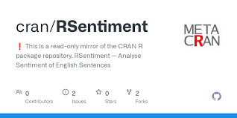
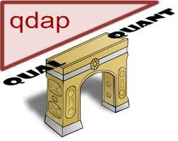
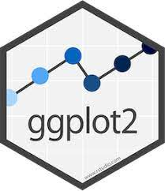




Packages Used
XML
Tidyverse
Rsentiment
Dplyr
Rvest
Stringr
Ggplot2
Wordcloud
Qdap
Tidytext
Textdata
tm
Ggthemes
ggrepel
Notes:
Analyses sentiment of a sentence in English and assigns score to it. It can classify sentences to the following categories of sentiments:- Positive, Negative, very Positive, very negative, Neutral.
™ - textmining
Rvest - Webscraping
Stringr - String manipulations in R
The ggthemes package provides extra themes, geoms, and scales for the ggplot2 package.
ggrepel provides geoms for ggplot2 to repel overlapping text labels:

Slide 5
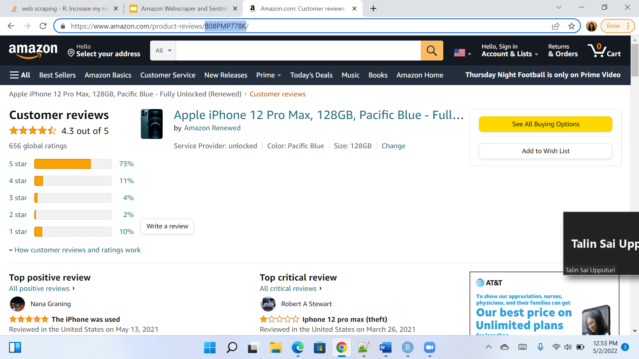
Web Scraper
ASIN
Extract Reviews using ASIN (Amazon Standard Identification Number)
Package used – Rvest
Rvest vs RSelenium
Notes:
One of the greatest headache from web scraping is that what you see in browser and what you get in response are different. By using RSelenium, you can avoid this issue.
It's very slow:
Since the browser loads everything on the web page(including photos, ads or even videos), it will be really slow comparing to making requests using httr or rvest. , RSelenium doesn't have a large user base and hence lacks support.

Slide 6
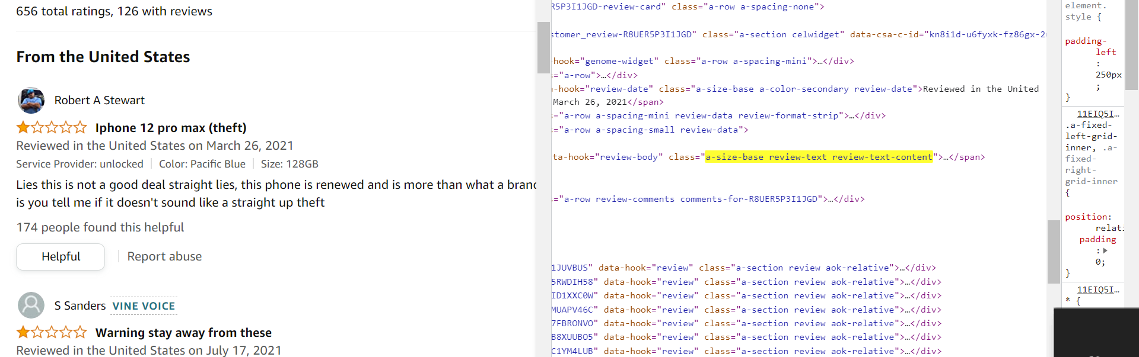
Web Scraper – Scraping content from HTML
function(ASIN, page_num){
url <- paste0("http://www.amazon.com/product-reviews/",ASIN,"/?pageNumber=",page_num)
product <- read_html(url)
product_title<-product %>% html_nodes("[class='a-size-base a-link-normal review-title a-color-base review-title-content a-text-bold']")%>% html_text()
product_text<- product %>% html_nodes("[class='a-size-base review-text review-text-content']") %>% html_text()
}
Notes:
we can introduce systematic delays in between the HTML reads to avoid overloading web servers in a short space of time, which at the same time also helps avoid yourself being picked up as ‘suspicious webscraping behaviour’.
anti-bot-detection
anti-bot-detection

Slide 7
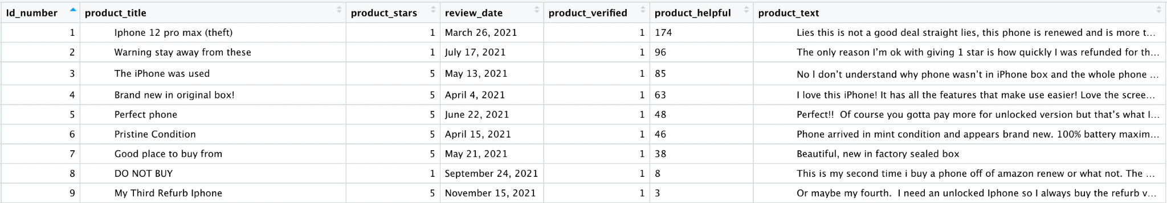
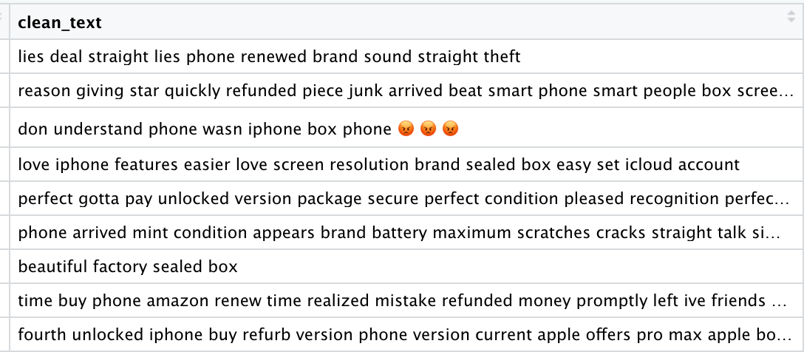
Web Scraping : Data Cleaning
Post Cleaning
clean_text = tolower(product_text),
clean_text =removeWords(clean_text,stop_words$word),
clean_text =str_replace_all(clean_text,"[,'`$+]", ""),
clean_text =str_replace_all(clean_text,"[[:punct:]]", " "),
clean_text =str_replace_all(clean_text,'[[:digit:]]+', " "),
clean_text =str_replace_all(clean_text,"[[:space:]]+", " "),clean_text = trimws(clean_text))
Notes:
ID number to unnest token
Product stars when extracted - 1.0 out of 5
gsub() which extracts digitvalue
Helpful - digits vs and text to value integers gsub()
Review date - remove punctuation. %D%M%Y

Slide 8
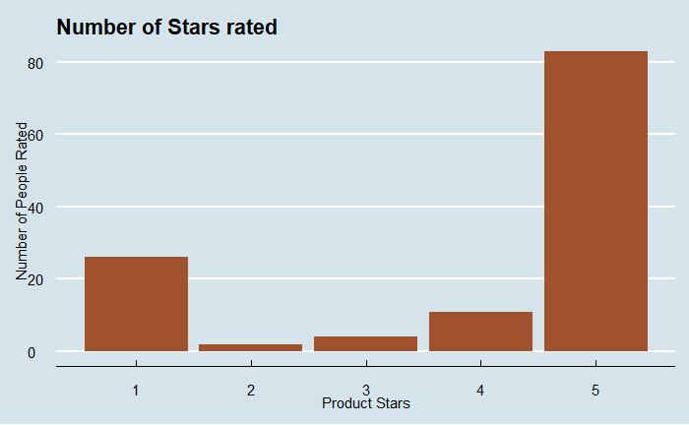
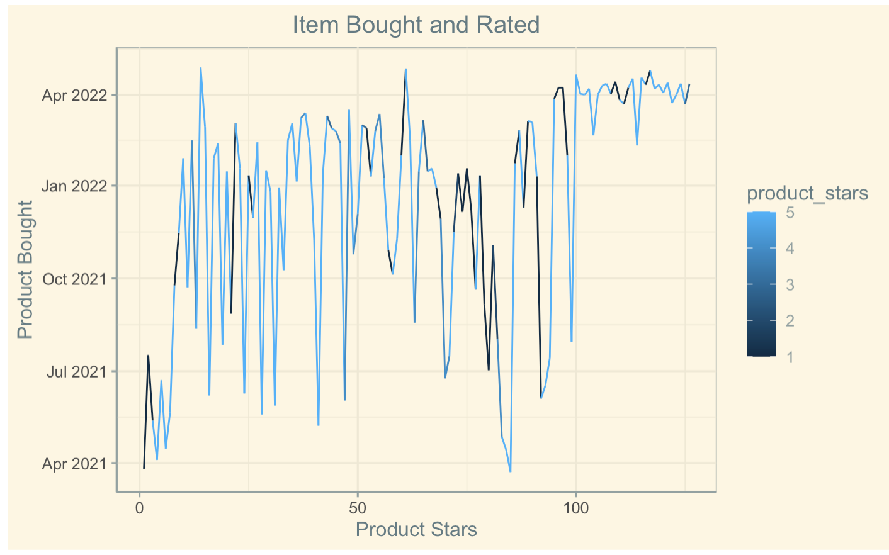
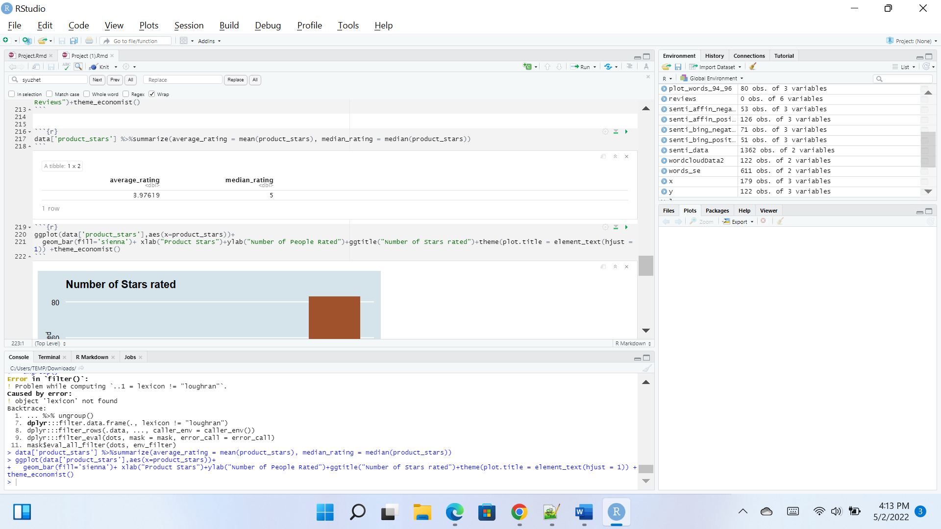
Statistics on Rating Extracted

Slide 9
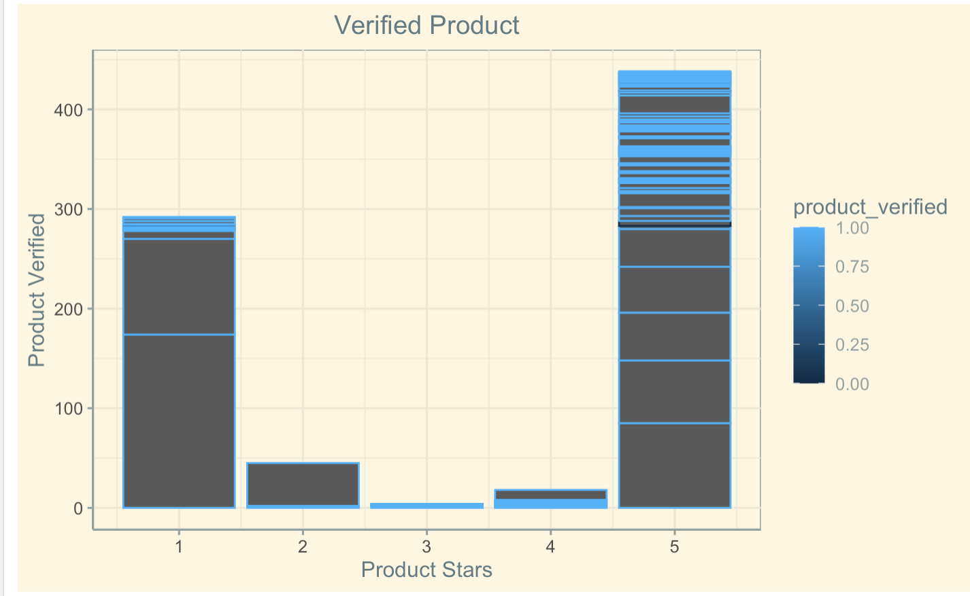
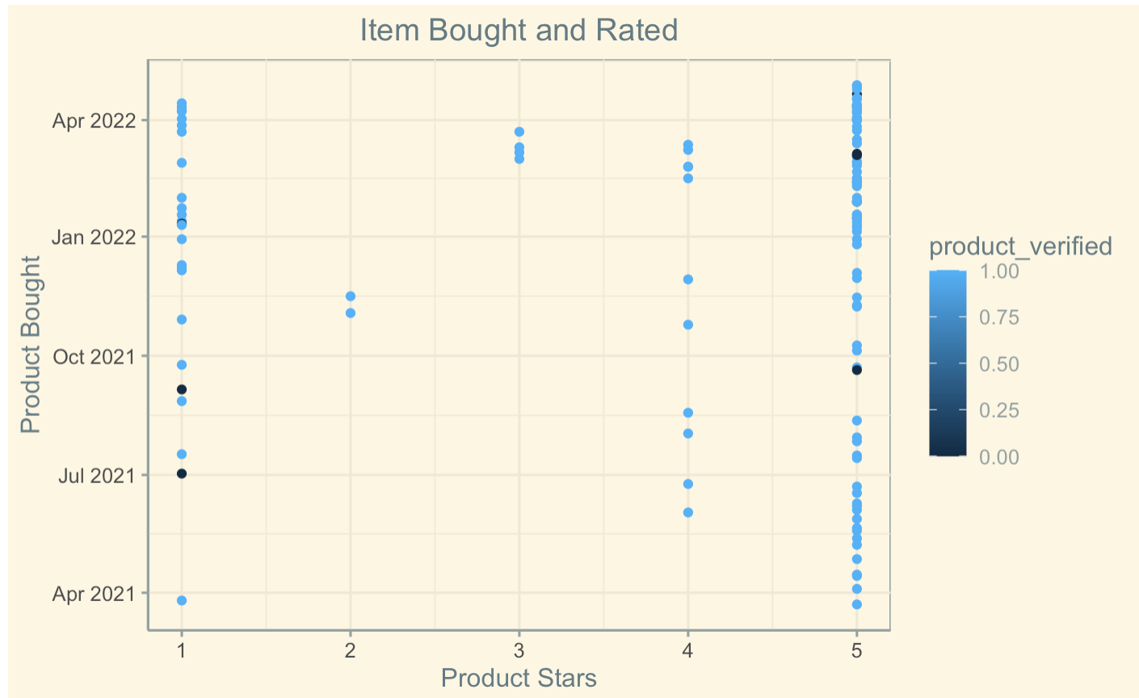
Statistics on Rating Extracted

Slide 10
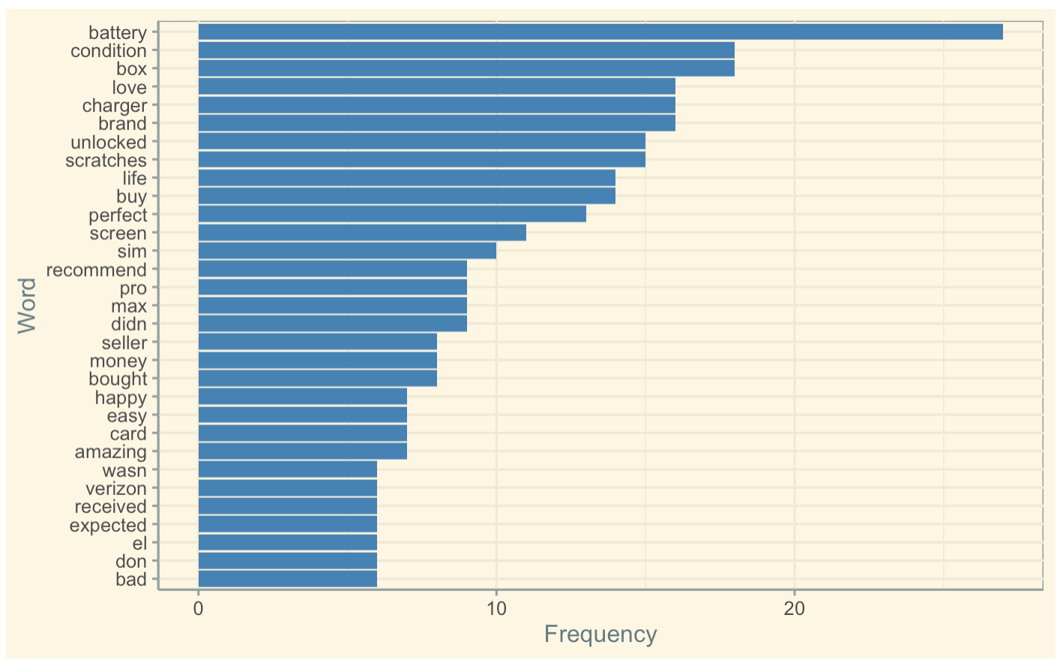
Common Words
Quantity Discourse Analysis Package(qdap) is which is designed to assist in quantitative discourse analysis.
Used Freq_terms argument for finding the most common words.
R-Code:-
most_common_word=freq_terms(text.var=senti_data$word,top=25,stopwords=c(Top200Words,"phone","iphone","apple","amazon","it's","product","i'm","phones"))
%>%
ggplot(most_common_word,aes(x = fct_reorder(WORD, FREQ, .desc=FALSE),y=FREQ))+
geom_bar(stat = "identity",fill = "steelblue")+
xlab("Word")+
ylab("Frequency")+
theme_solarized()+
coord_flip()

Slide 11
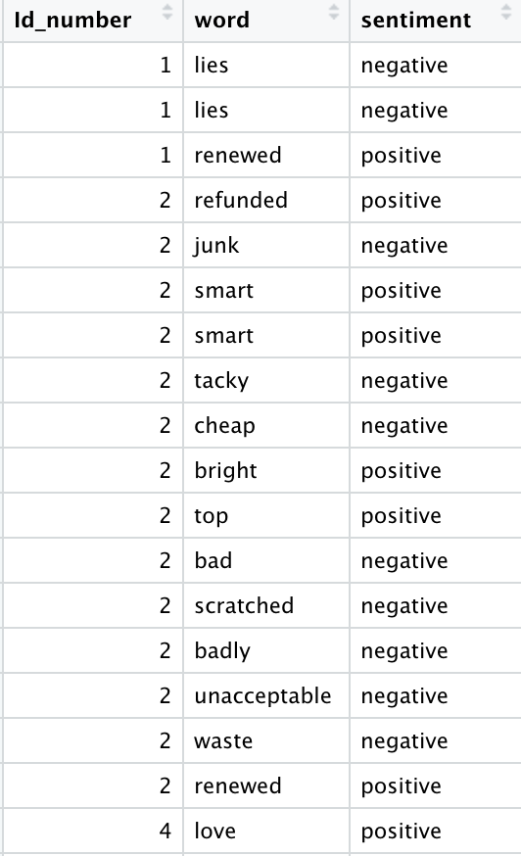
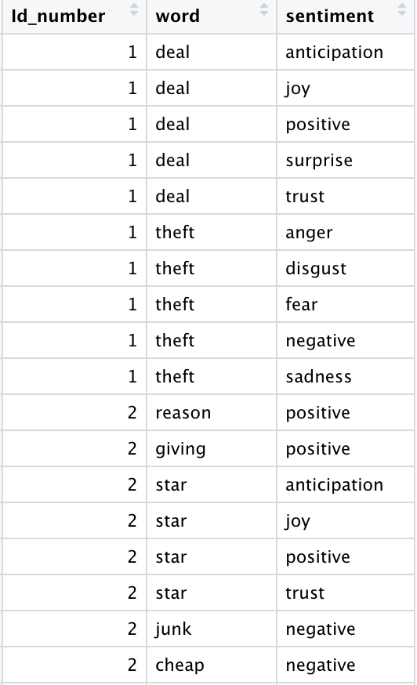
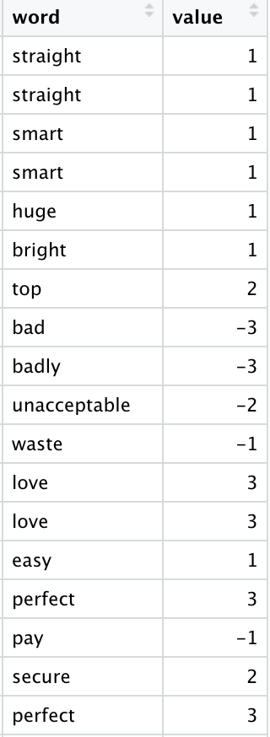
Sentiment Analysis
AFINN
BING
NRC
AFINN Words are given a polarity score between -5 to +5 based on how negative or positive they are
Bing
Categorize words by positive or negative only NRC
Assign words based on emotional categories: anger, anticipation, disgust, fear, joy, sadness, surprise, trust, negative, or positive

Slide 12
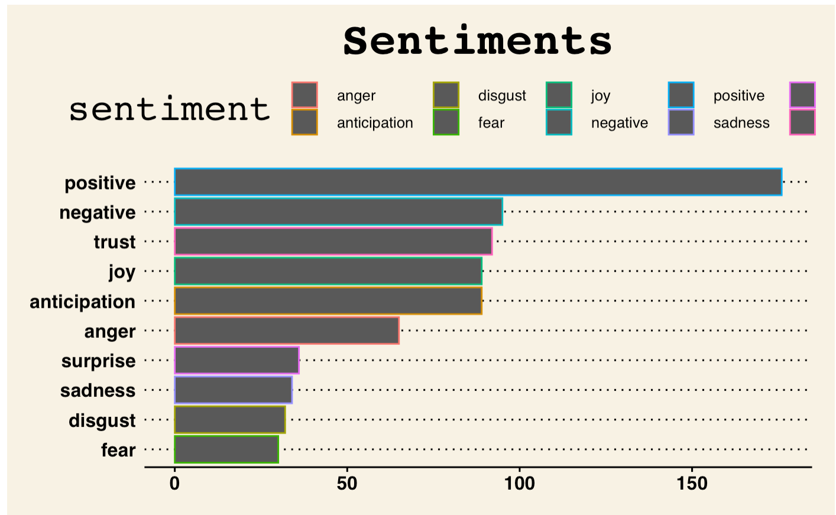
NRC Lexicon
senti_data %>%
select(word)%>%
inner_join(get_sentiments('nrc'))%>%
group_by(sentiment)%>%
count()%>%
ggplot(aes(x=reorder(sentiment,X = n),y=n,color=sentiment))+geom_col()+ guides(fill=F)+
coord_flip()+
theme_wsj()+xlab("Number of Sentiments")+ylab("NRC Sentiments")+ggtitle("Sentiments")+ theme(plot.title = element_text(hjust = 0.5))

Slide 13
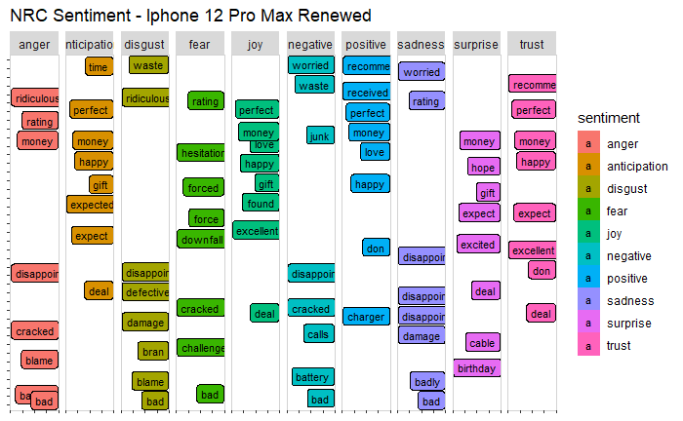
Ggrepel package is used in ggplot to repel overlapping text labels
geom_label_repel is used for this graph

Slide 14
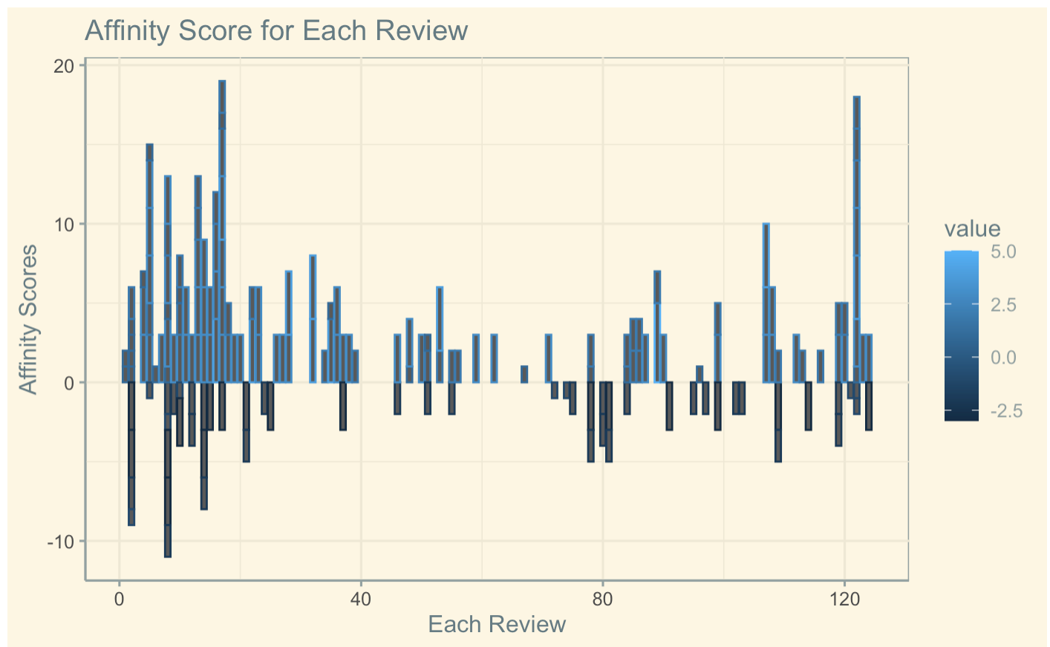
Affin Lexicon
Affinity Score is plotted for each review
R-Code:-
x %>% ggplot(aes(Id_number,value,color=value))+geom_bar(stat = "identity")+xlab("Each Review")+ylab("Affinity Scores")+ggtitle("Affinity Score for Each Review")+theme(plot.title = element_text(hjust = 0.5))+theme_solarized()

Slide 15
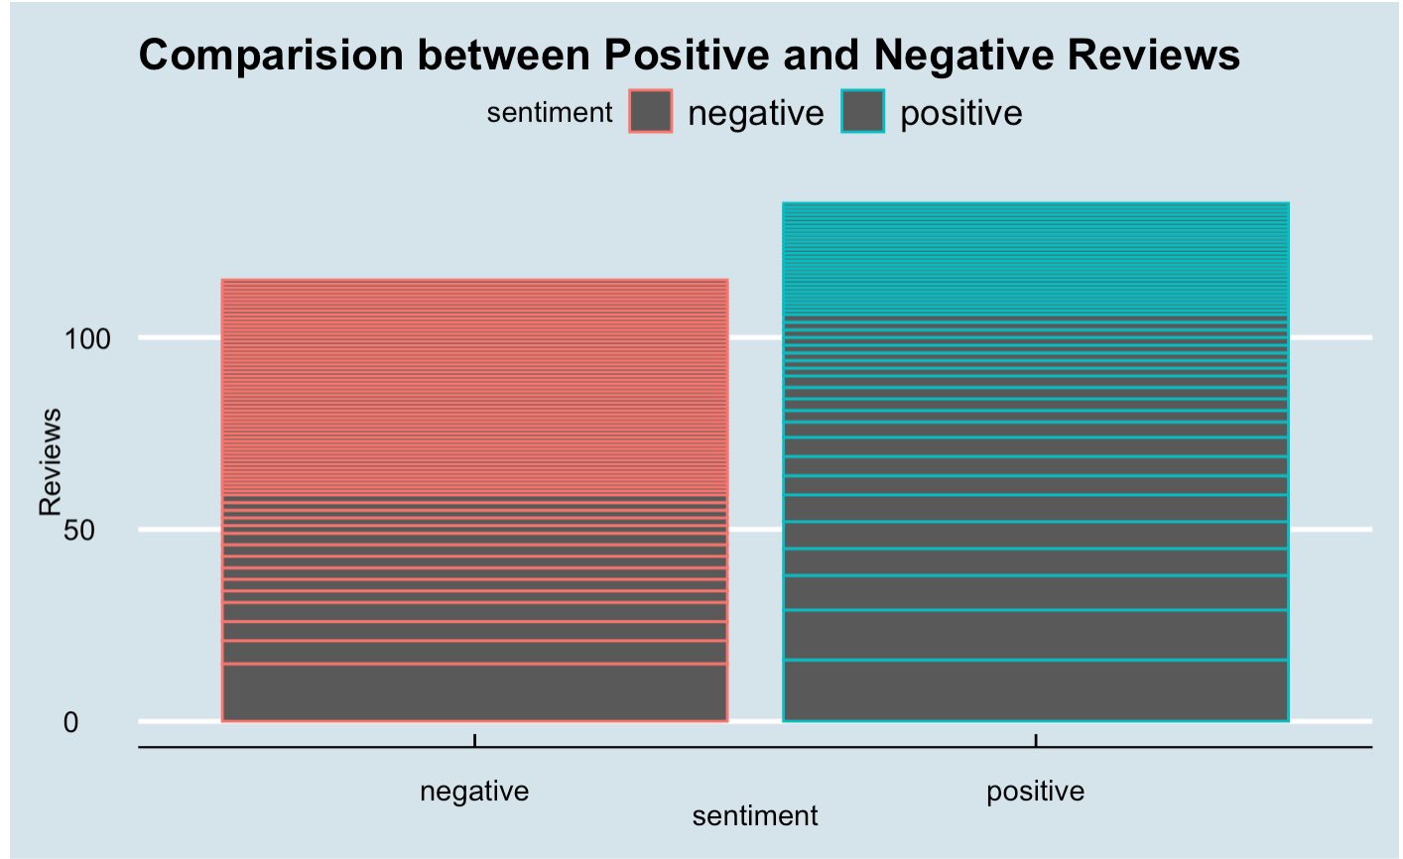
Bing Lexicon
Bing Lexicon is used by grouping by sentiment.

Slide 16
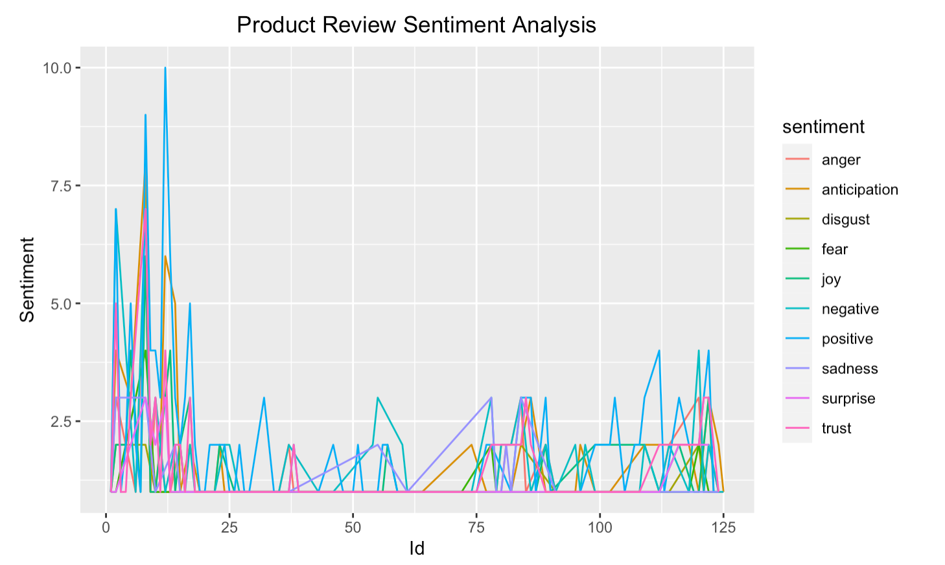
NRC vs Id_number
cloud_1 %>% unnest_tokens(word,clean_text) %>% group_by(Id_number)%>% inner_join(get_sentiments('nrc')) %>% count(sentiment,sort = TRUE)%>% ggplot(aes(Id_number,n,color=sentiment))+geom_line()+ggtitle("Product Review Sentiment Analysis") +theme(plot.title = element_text(hjust = 0.5)) +xlab("Id")+ylab("Sentiment")

Slide 17
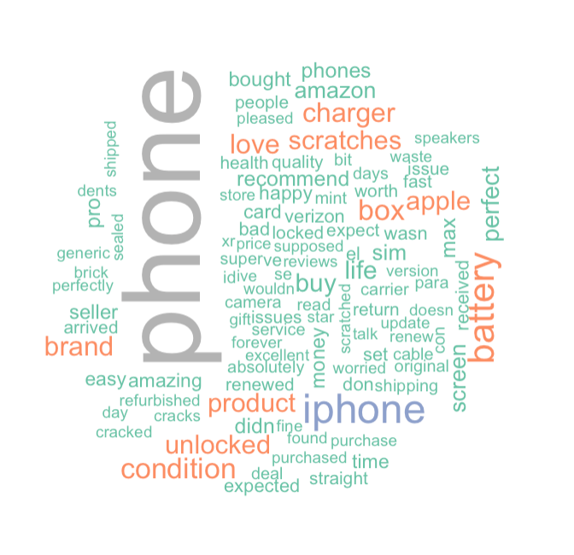
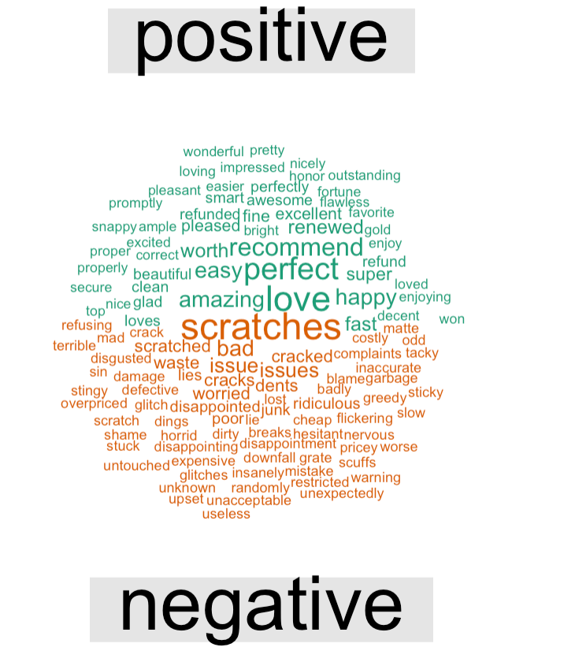
Word Cloud
To plot the comparison cloud we used bing lexicon and then plotted using naming two new columns

Slide 18
Thank You!

